Slide 1
Soaring Acorn Airlines to Greater Heights
Flying for a better tomorrow

Slide 2
Table of Contents
01
02
03
04
Context
Flight turnaround
Our Share of the Airline Industry
Our Flight Turnaround Rate
Arrival Delays
Solution
Factors affecting it for both the airlines
How do we Boost Our Effectiveness

Slide 3
Background
Context
How we stack against Berry Airlines

Slide 4
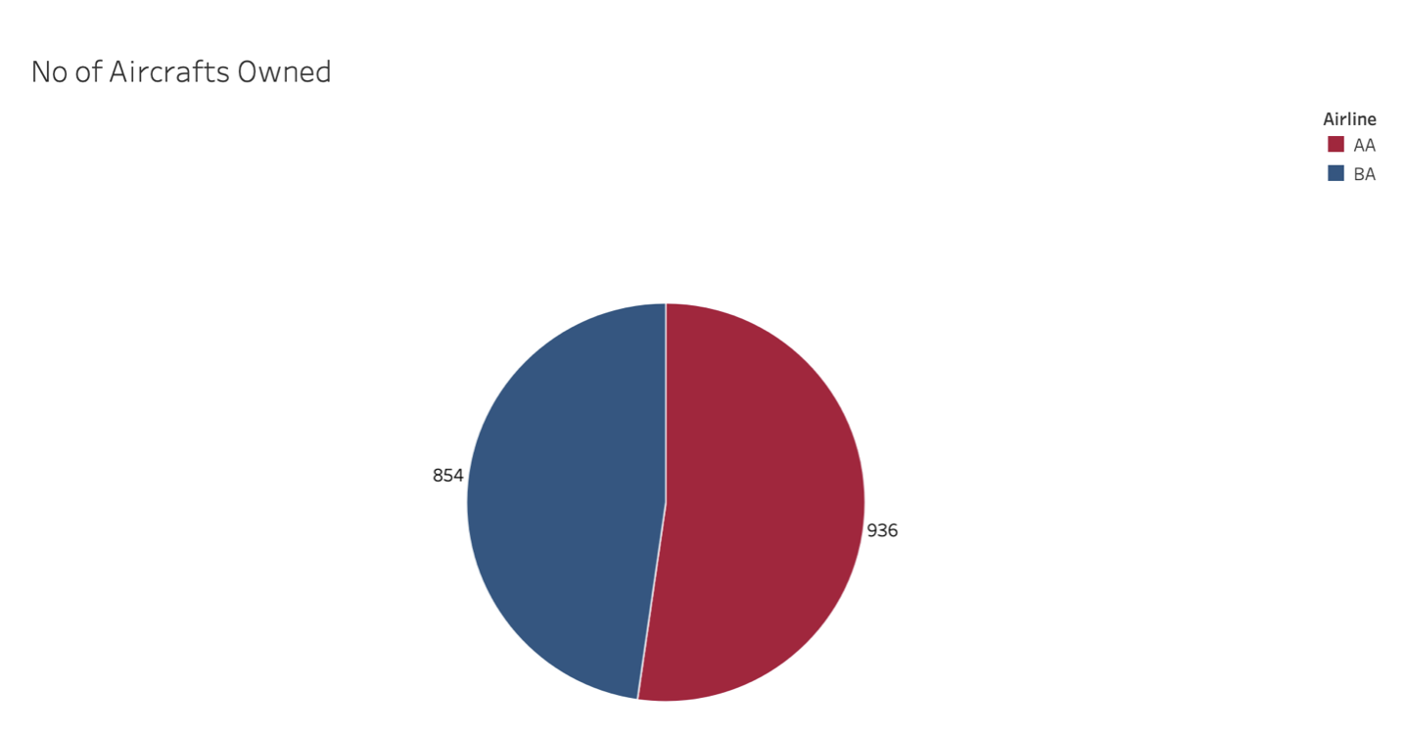

Share of Flights
We own 52.3% of Aircrafts
Berry Airlines owns 47.7%

Slide 5
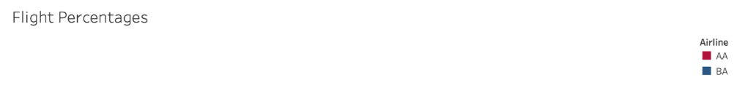
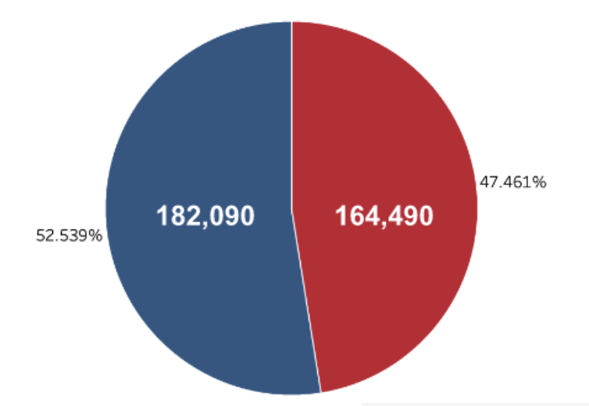

Share of Flights
Yet Berry Airlines manages
5%
more flights than us

Slide 6
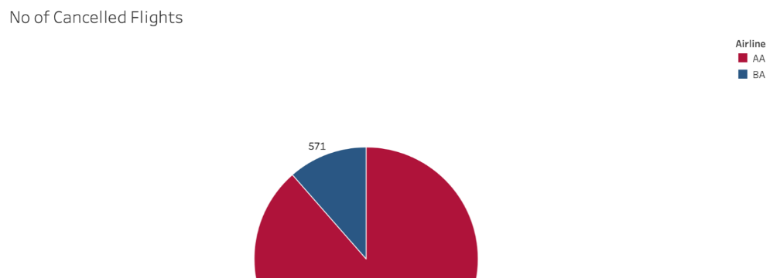
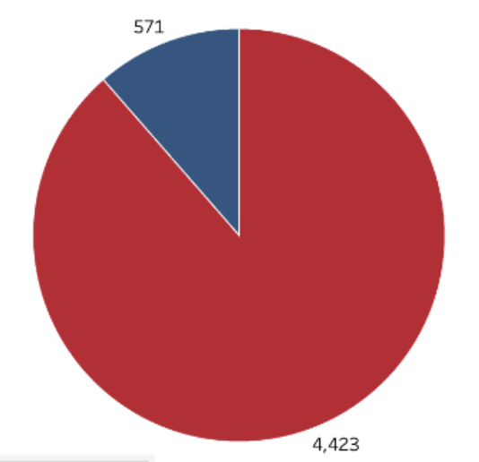

Portion of Cancelled Flights
87%
More cancelled Flights than Berry Airlines

Slide 7
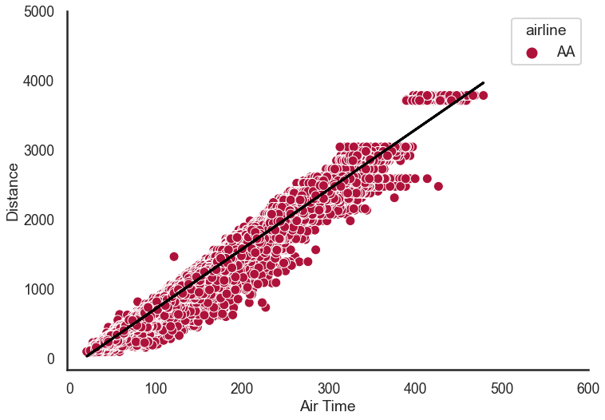
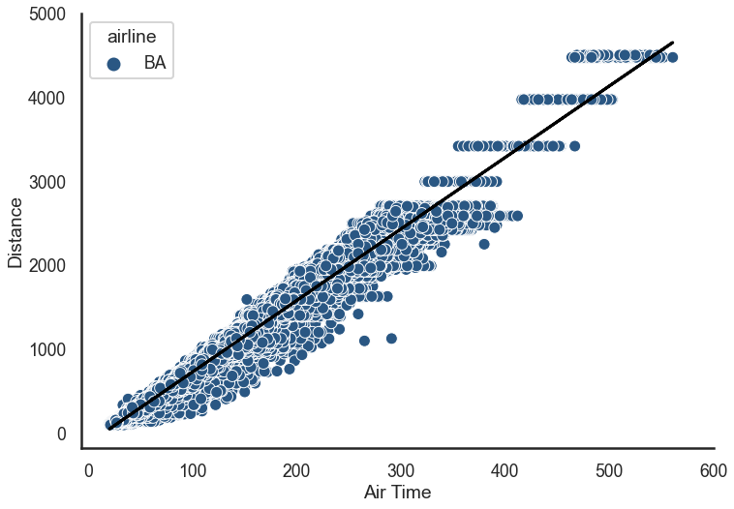
Air Time to Distance by Airline
8.58 miles/mins
828.5 km/h
8.51 miles/mins
821.7 km/h

Slide 8
Flight Turnaround
Acorn Airlines vs Berry Airlines

Slide 9

What is Flight Turnaround?
Time that passes between landing and take-off of the next flight
mins

Slide 10
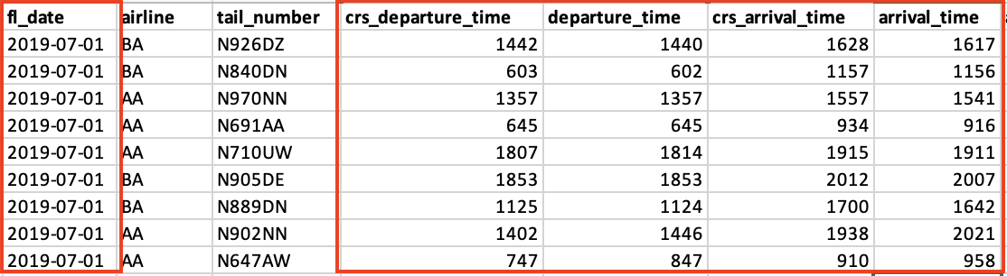

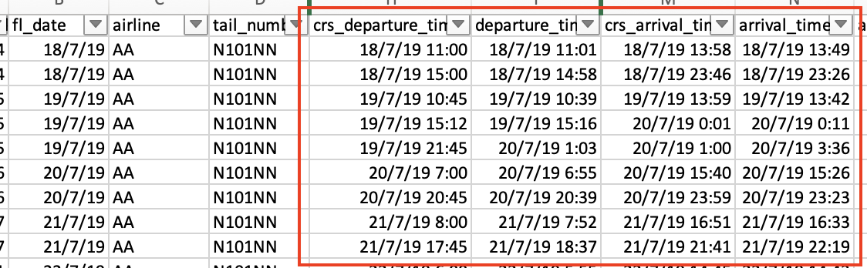
Data Cleaning Process
Created timestamps while accounting for
Time-zone Differences
Next day timestamps

Slide 11
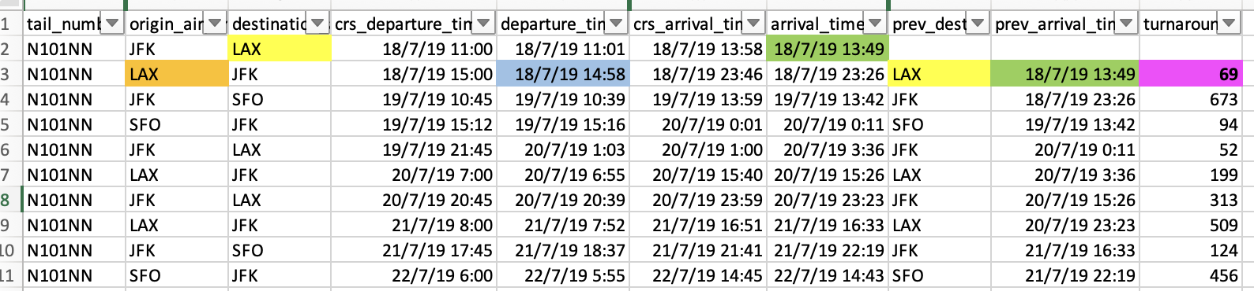
Turnaround Calculation
Sorted by tail_number, departure_time to get flight order
Check: Previous Flight Destination same as Current Flight Origin
Calculate: departure_time - prev_arrival_time = turnaround

Slide 12
What is the Industry Standard?
90 - 120 mins
Source: International Air Transport Association (IATA), AeroTime

Slide 13


Why does it matter?
“The plane is not making any money while it is on the ground”
Opportunity Costs
Other Costs

Slide 14
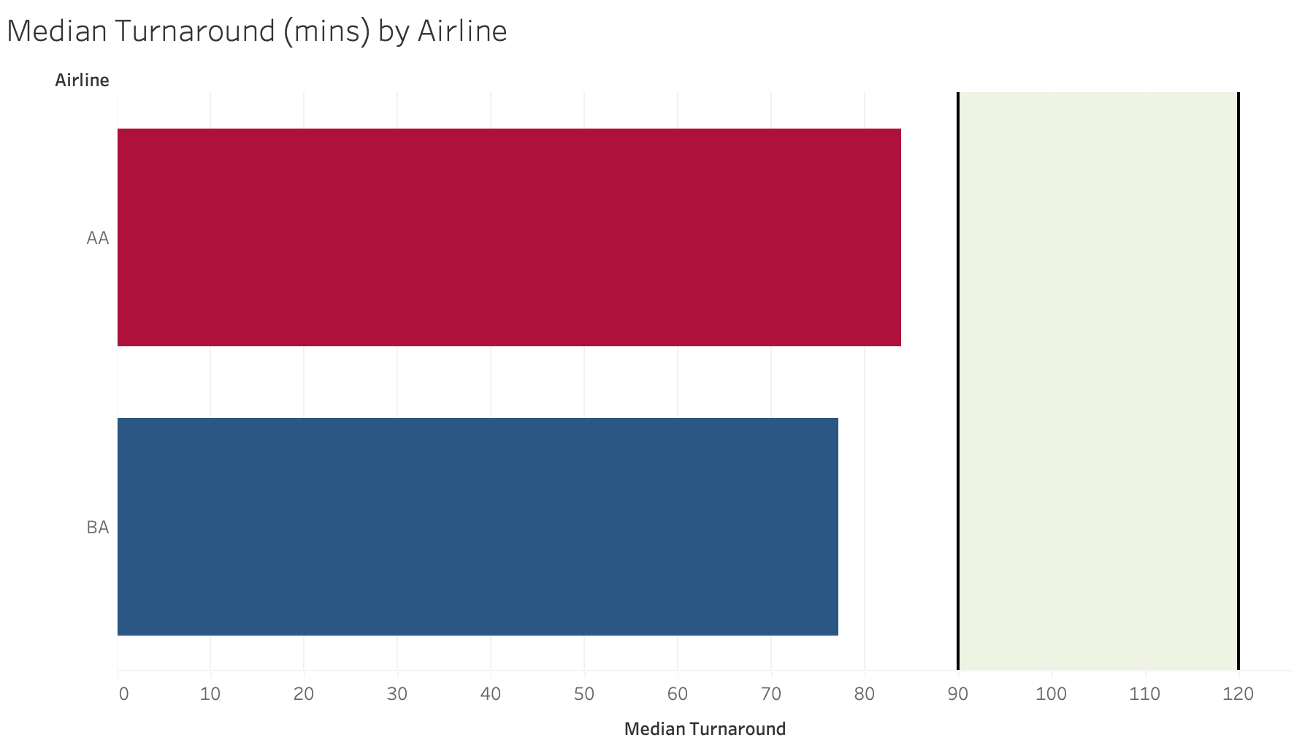
Median Turnaround AA vs BA
Industry Standard = 90 mins
High End = 120 mins
AA
84 mins
6.75 min Longer Median Turnaround
Compared to Berry Airline
BA
77.25 mins

Slide 15
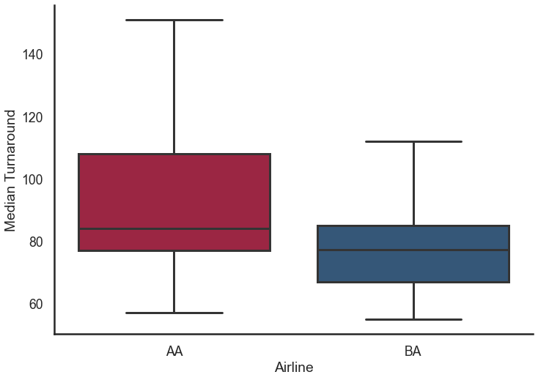
Median Turnaround Distribution
154.5 mins
197 of 936 Flights of AA (21%) are outliers
112.0 mins
84 mins
85 of 852 Flights of BA (10%) are outliers
77.25 mins
*Cutoff = 75th Quartile + 1.5x IQR

Slide 16
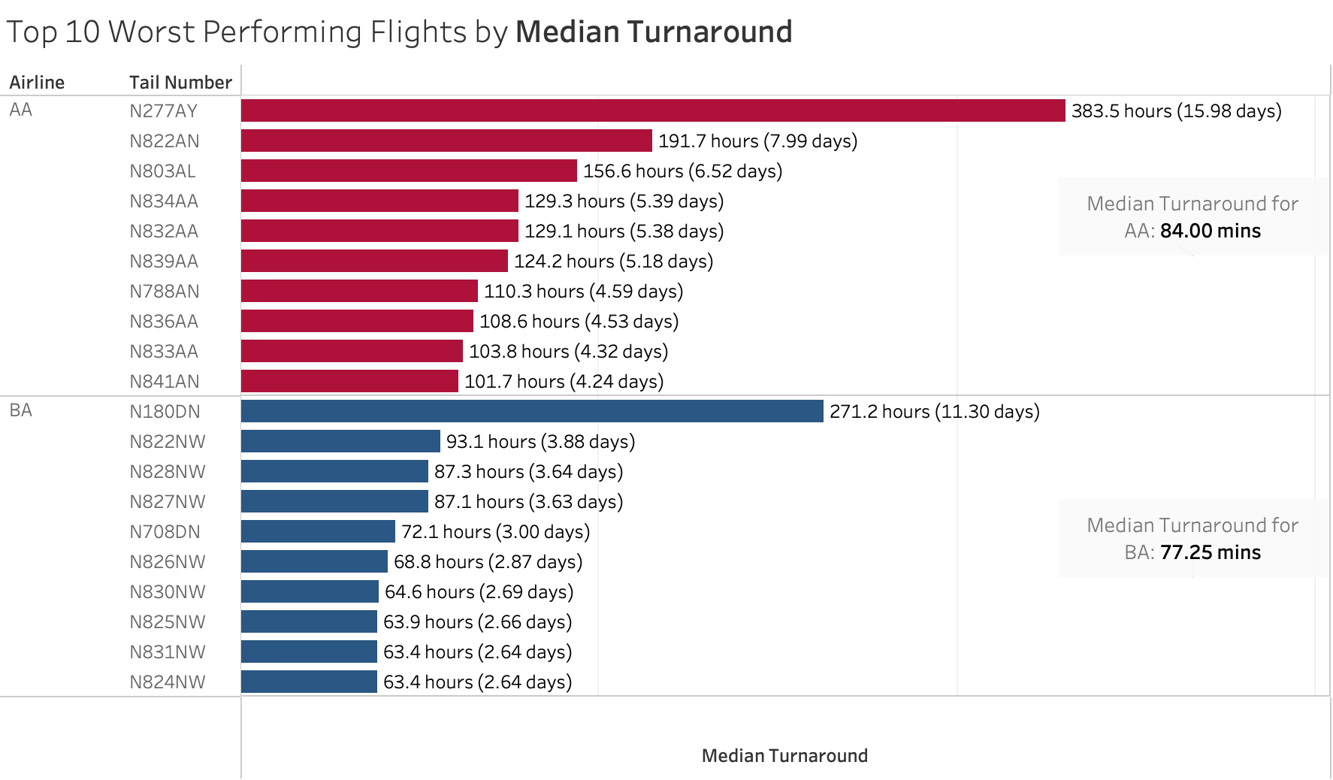
Worst Performers

Slide 17
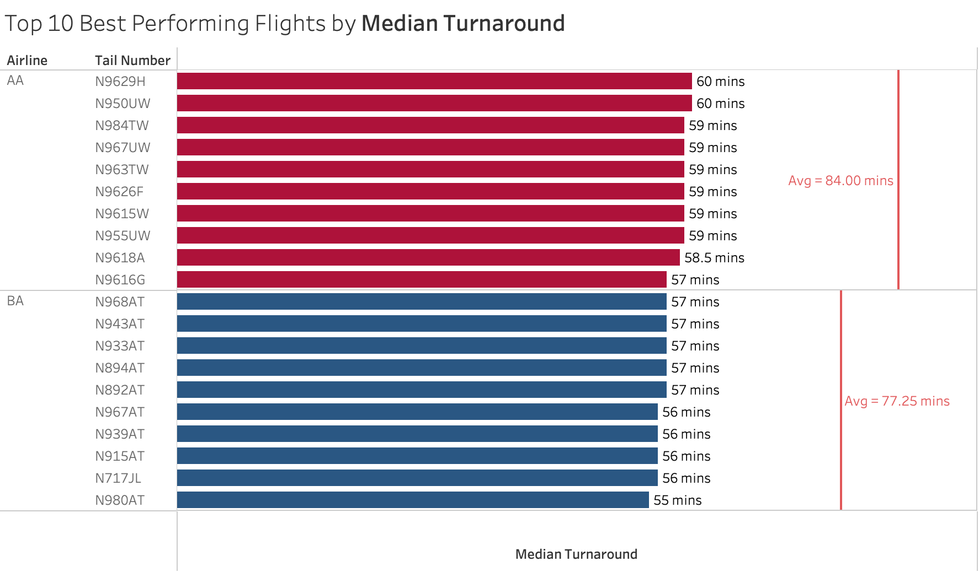
Best Performers

Slide 18


% under 90m turnaround
Below 90 mins, 65.28%
Below 90 mins, 82.98%
AA
BA
Over 90 mins, 17.02%
Over 90 mins, 34.72%

Slide 19


% under 120m turnaround
Below 120 mins, 77.78%
Below 120 mins, 90.73%
AA
BA
Over 120 mins, 9.27%
Over 120 mins, 22.22%

Slide 20
Arrival Delays
Factors affecting it

Slide 21
Why does it matter?
“Customers reaching on the stipulated time is at the heart of their satisfaction”
Customer Loyalty
Operational Delays

Slide 22
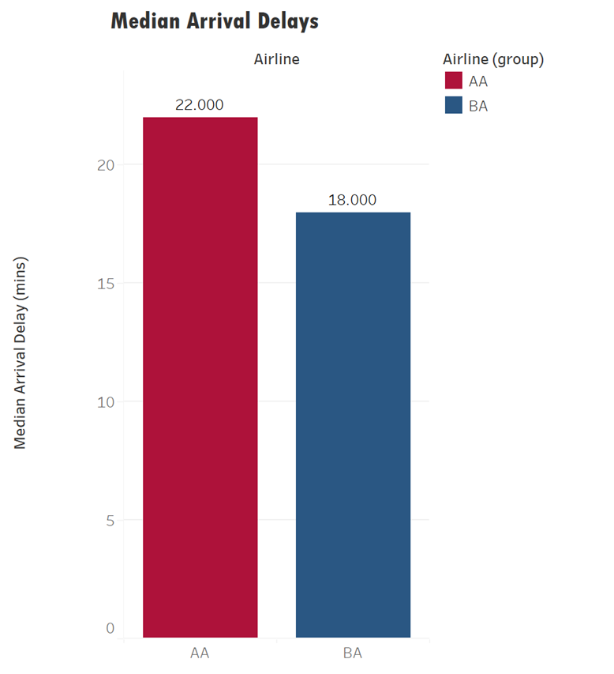

AA vs BA (Arrival Delays)
Our median arrival delay is higher than Berry Airlines

Slide 23
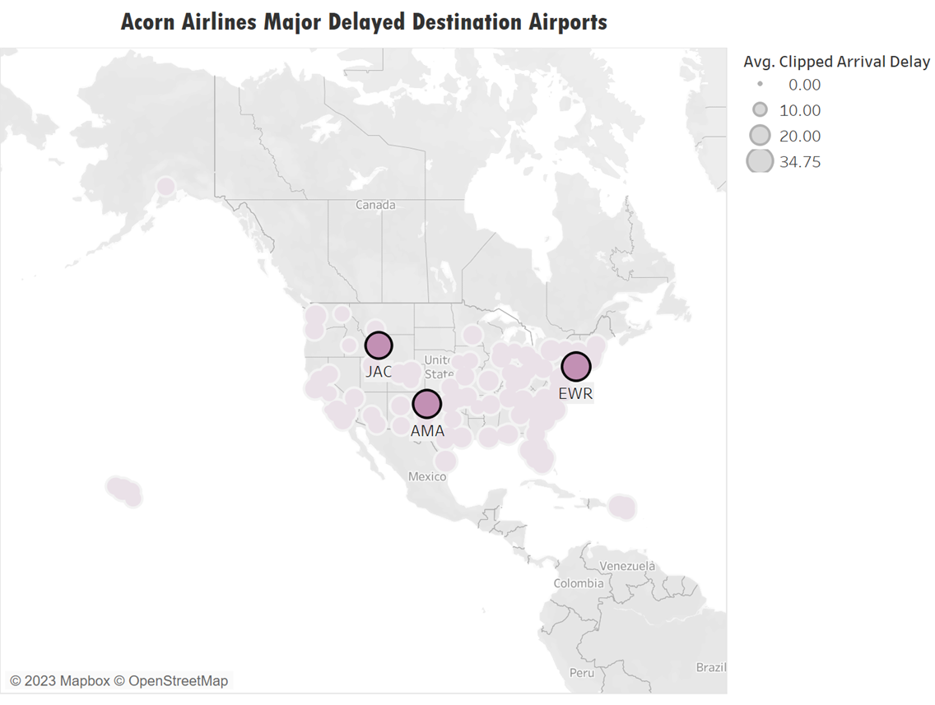
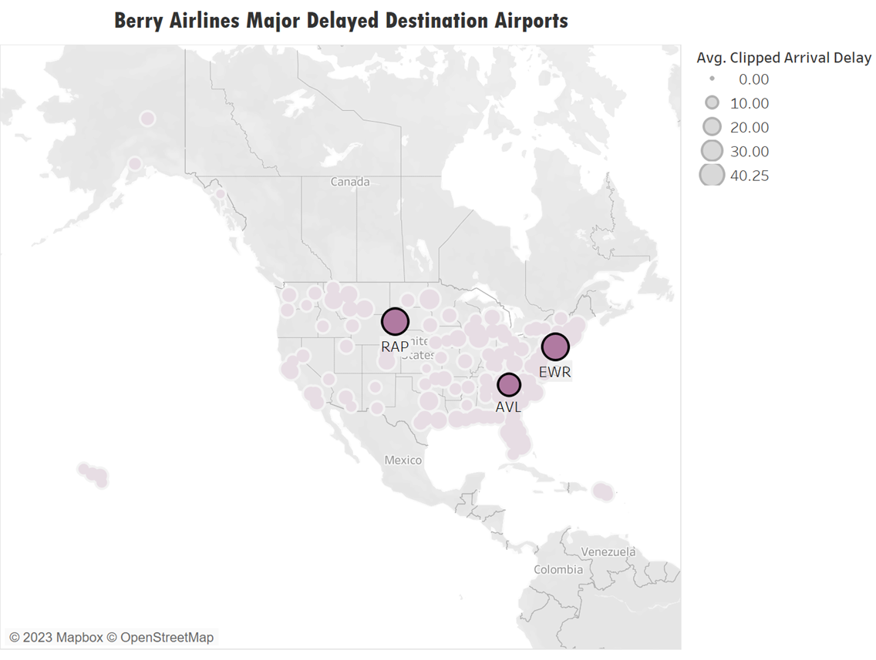
Delayed Destination Airports

Slide 24
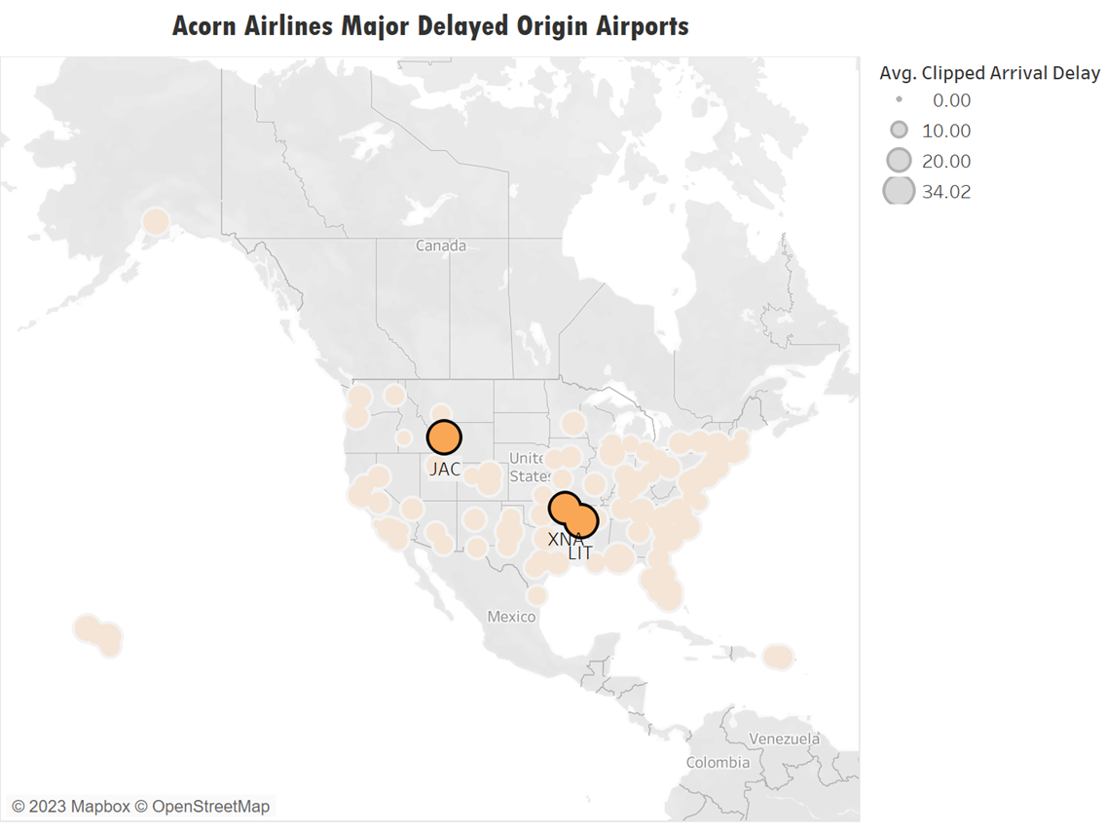
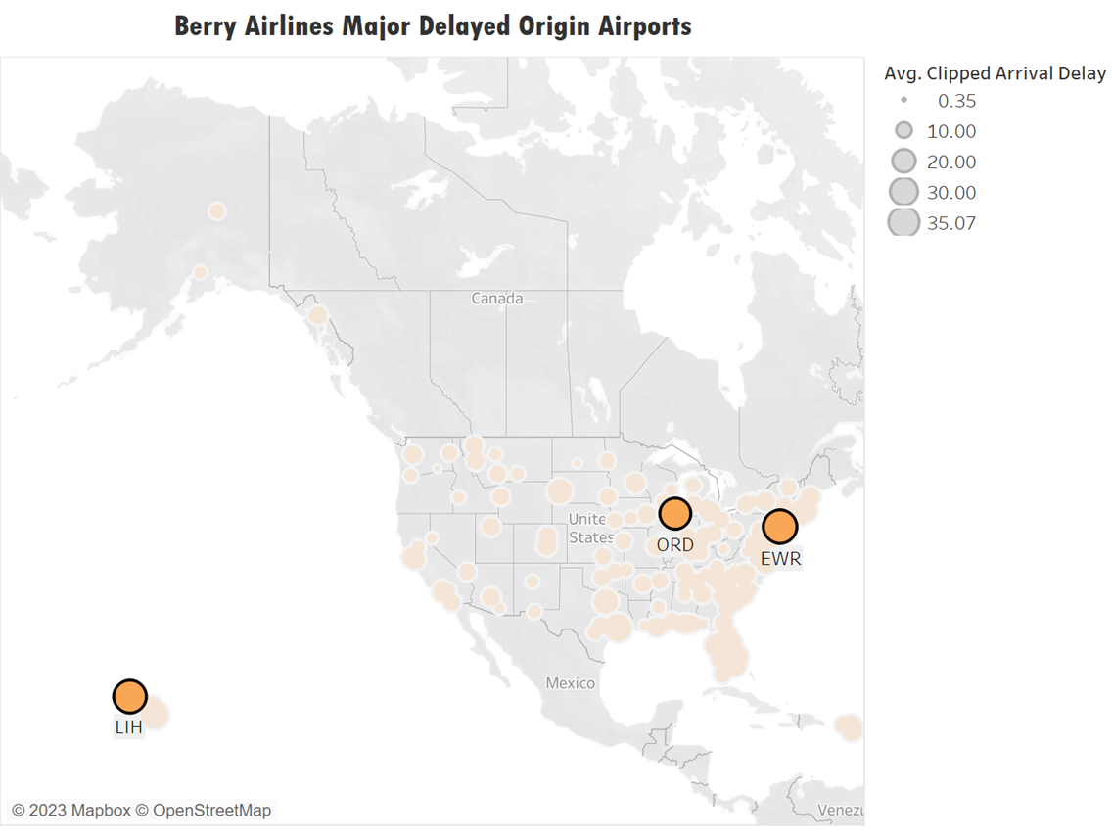
Delayed Origin Airports

Slide 25
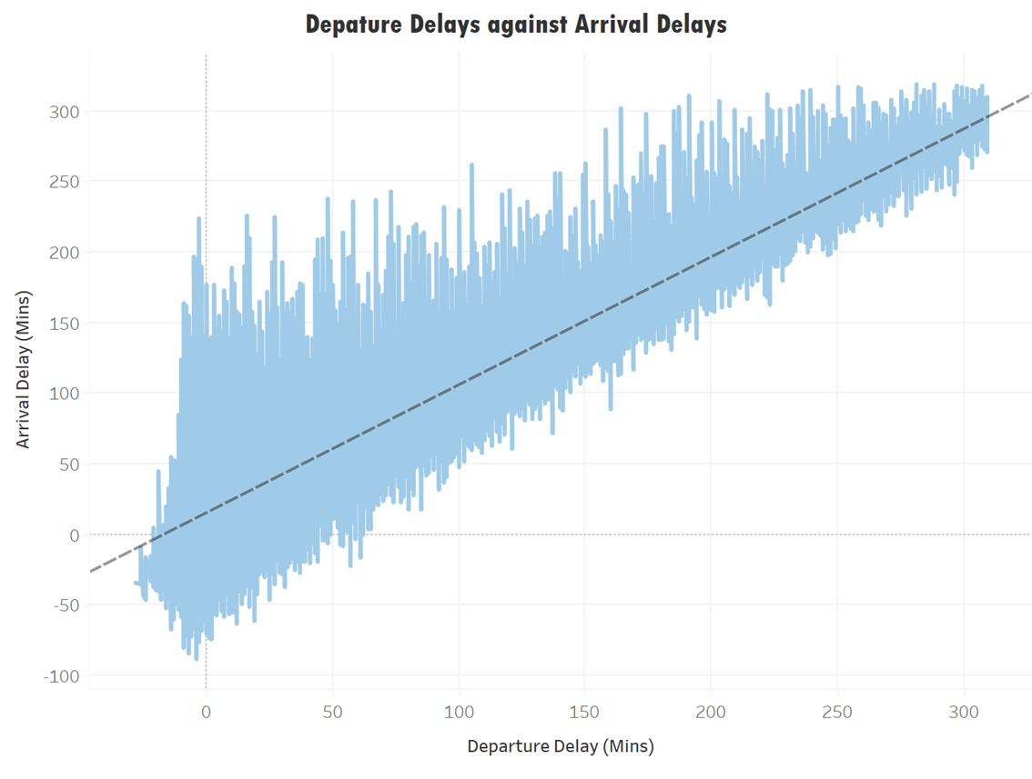

Effect of Departure Delay
Arrival Delay increases with Departure Delay
There are significant number of flights with further delay on top of Departure Delay

Slide 26
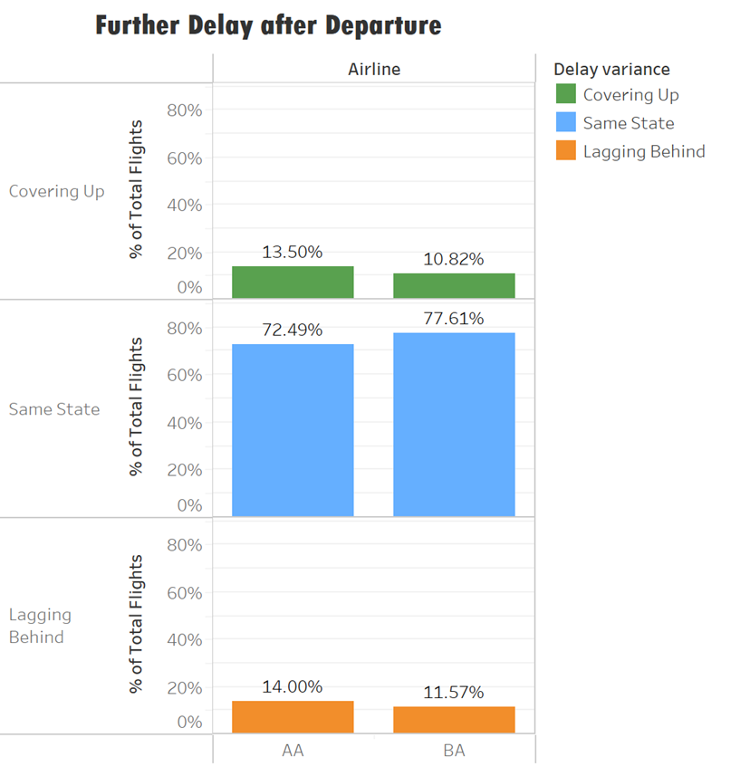


State after Take-off
More flights covering up compared to BA
A higher % of flights lagging behind.
Lower % in consistency with schedule.

Slide 27
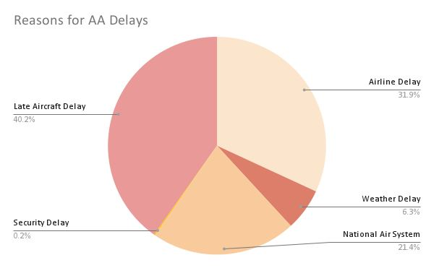
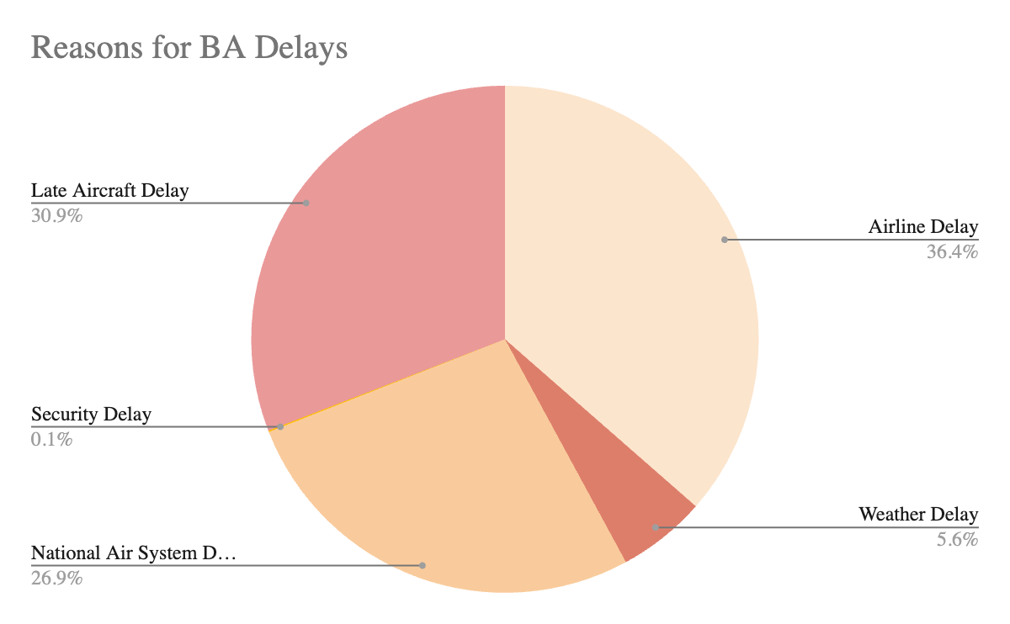

Reasons for each delay
We have a greater percentage of late aircraft delay
BA has a higher percentage of Airline Delay

Slide 28
What is the Industry Standard?
Industry Median Taxi-In time is
7 Minutes!
From our own dataset!

Slide 29
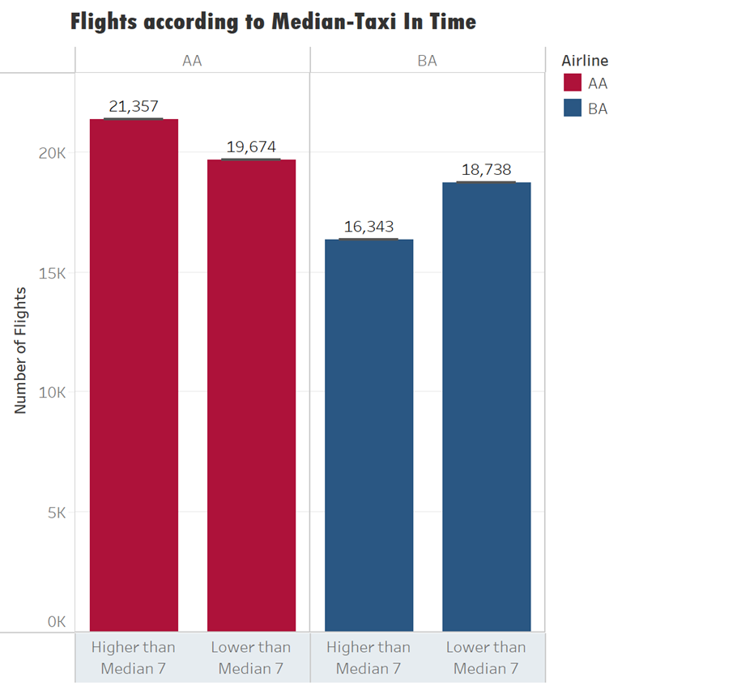
Taxi-in to Industry Median
Acorn Airlines has a higher proportion of flights with Taxi-in time higher than the industry median.

Slide 30
Solutions

Slide 31




Categories
1
2
3
4
Aircraft Optimisation
Flight Activity Delays Mitigation
Capitalising on our Systems & Operational Advantages
Systems & Operational Delays Mitigation

Slide 32
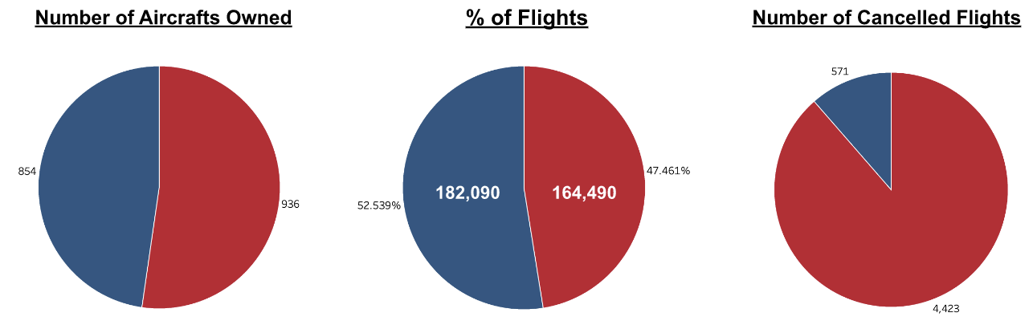
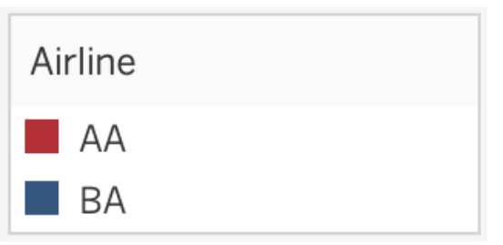
1. Solutions for Aircraft Optimisation

Slide 33



1. Solutions for Aircraft Optimisation
Solution A
Adopt Real-time Tracking Technologies on Aircraft
Proactively monitor conditions of aircrafts,
Leveraging on quantity advantage and arrange backups when needed
Solution B
Investing in Synchronised Communication between Involved Stakeholders
Real-time preemption on any contingency plans adopted
Solution C
Effective Streamlining of Active Maintenance Checks
Arranging adequate manpower to conduct regular checks

Slide 34
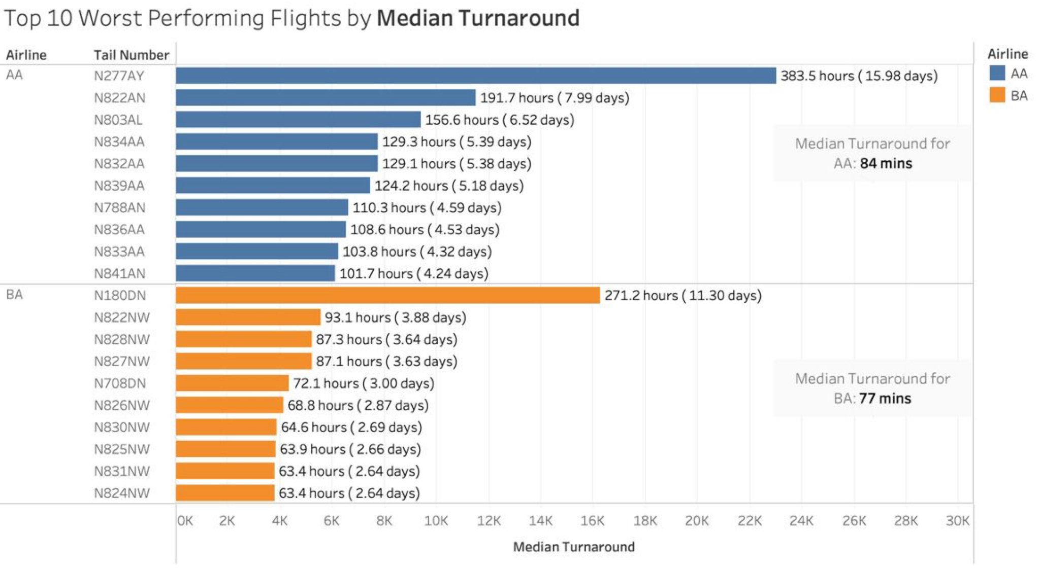

1. Solutions for Aircraft Optimisation
Solution D
Adopting Descriptive, Predictive & Prescriptive Analytics

Slide 35
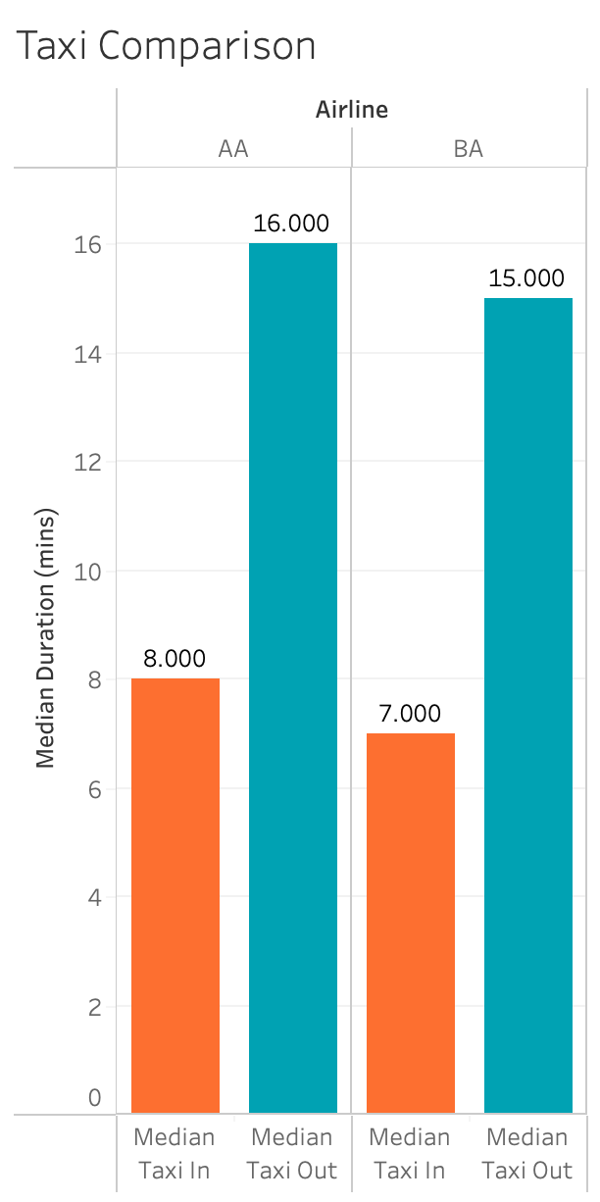
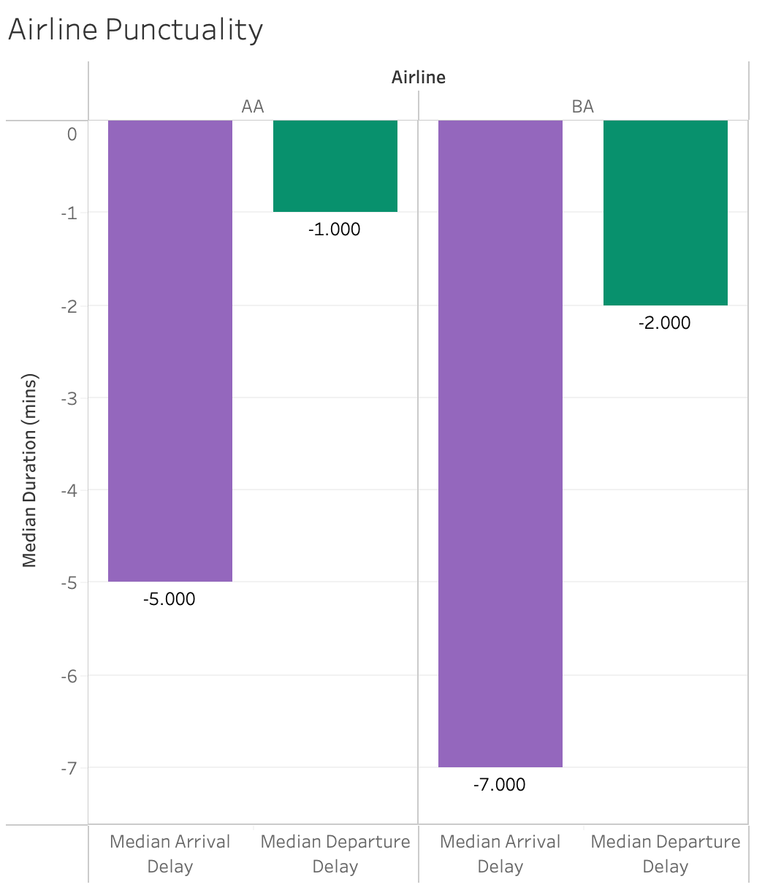
2. Solutions for Flight Activity Delays Mitigation

Slide 36
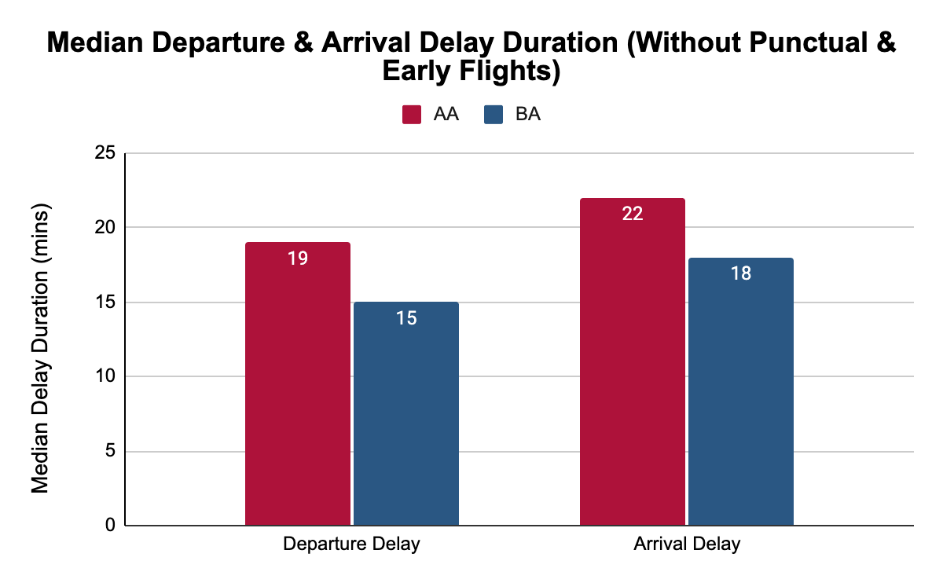
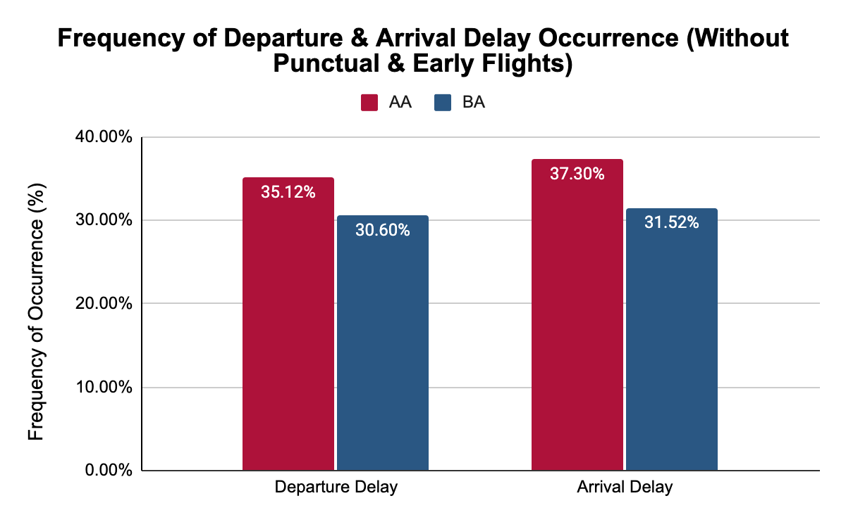
2. Solutions for Flight Activity Delays Mitigation

Slide 37


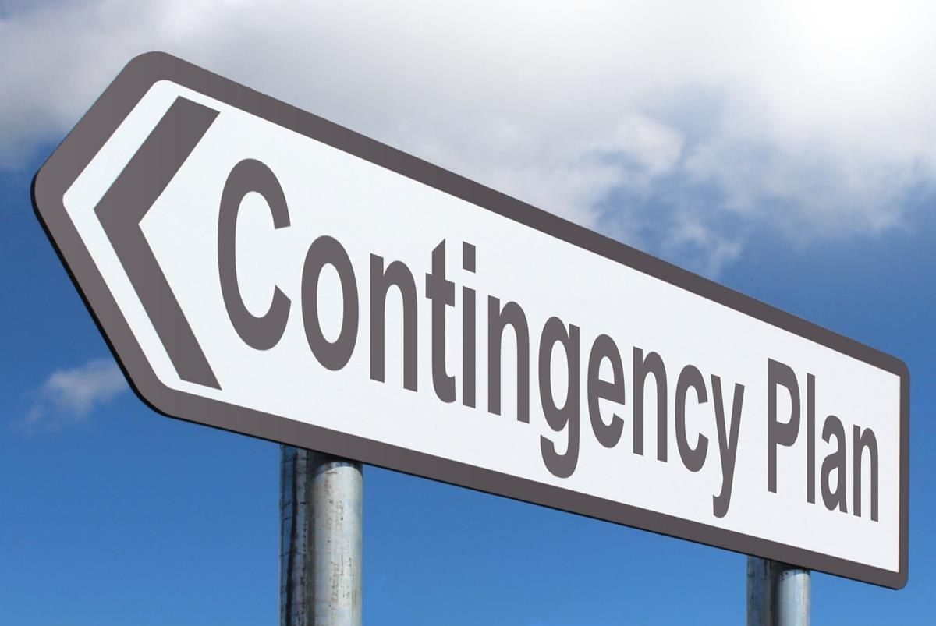
2. Solutions for Flight Activity Delays Mitigation
Solution E
Time-based Flow Management Algorithm for Taxiing
Timely information
Uses prescriptive analytics to suggest taxi schedule
Solution F
Effective Streamlining of Pre-departure Protocol
Synchronised digital checklist
Real-time updates
Solution G
Optimise Flight Arrival Schedule & Contingencies
Ensure sufficient buffer time
Prevent domino effect

Slide 38
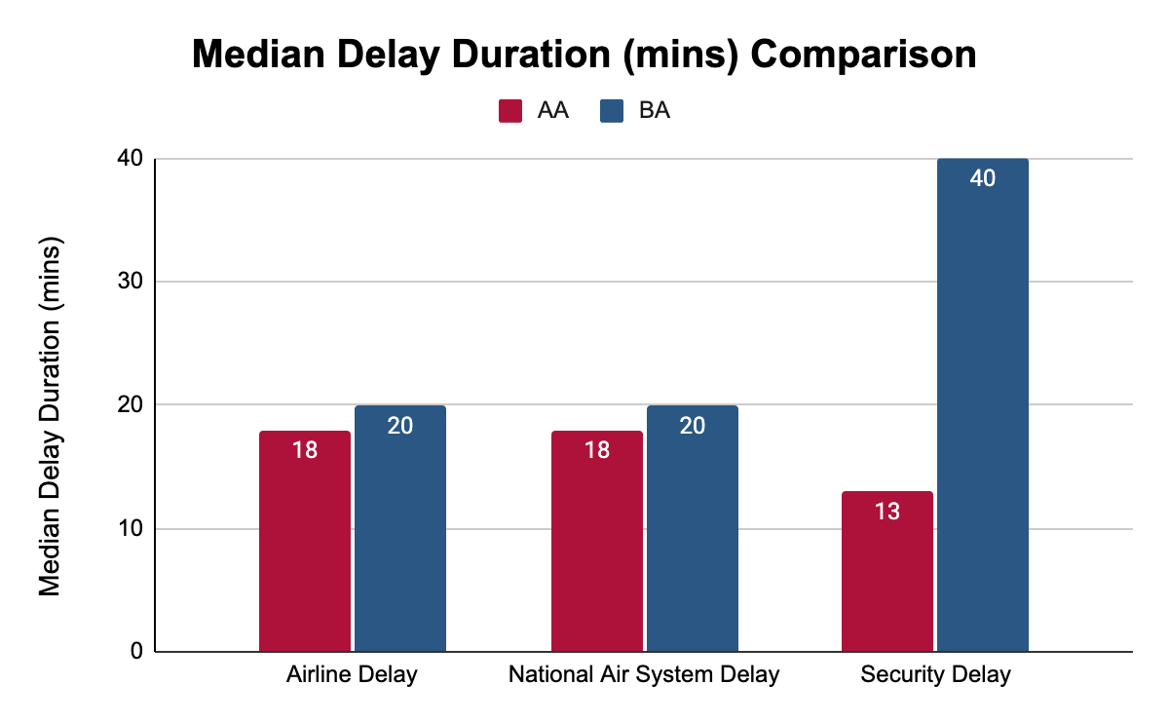
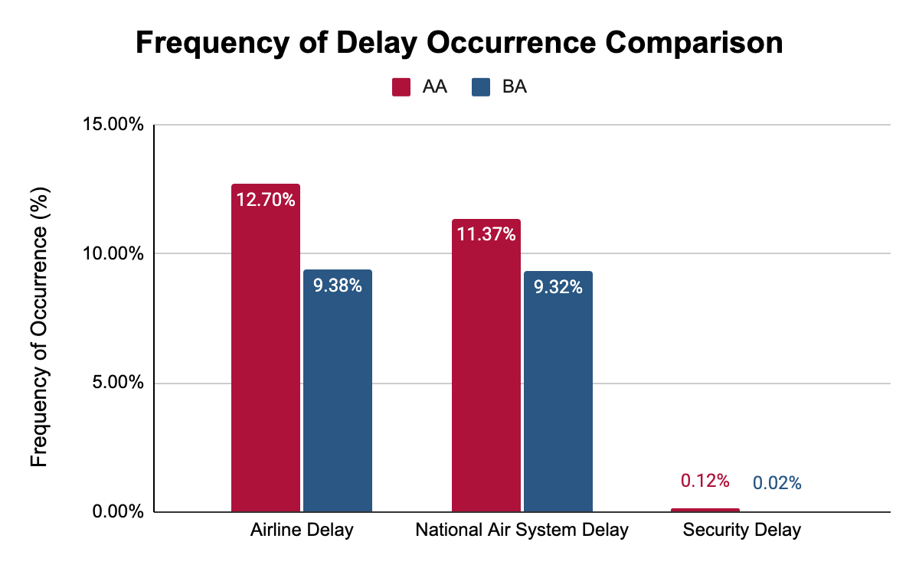
3. Solutions for Capitalising on our Systems & Operational Advantages

Slide 39


3. Solutions for Capitalising on our Systems & Operational Advantages
Solution H
Optimise Manpower and Resources Deployment
Adequate staff distribution
Ensure smooth flow of procedures
Solution I
Streamlining Security Procedures with the Aid of Automation
Speed up screening process
Reduce required manpower
Notes:
Solution H for Airline carrier and National Delay I for weather and late aircraft that needs to be diverted because of weather

Slide 40
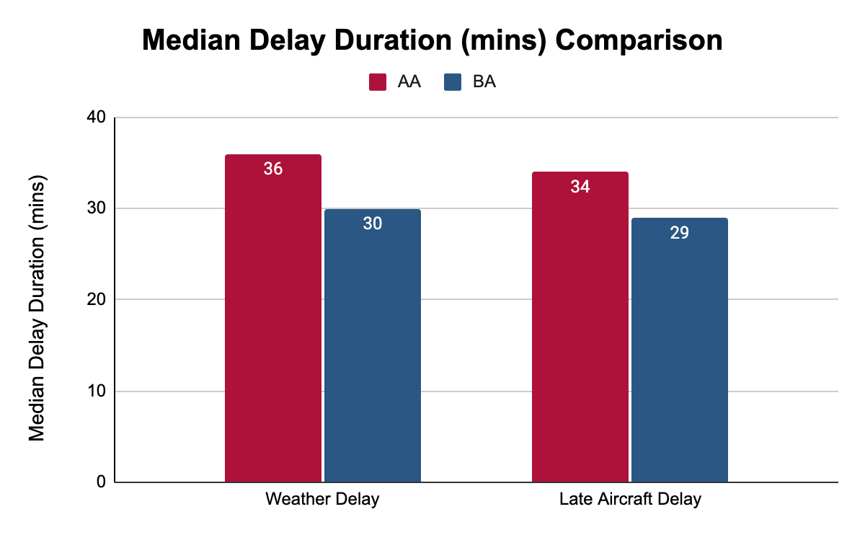
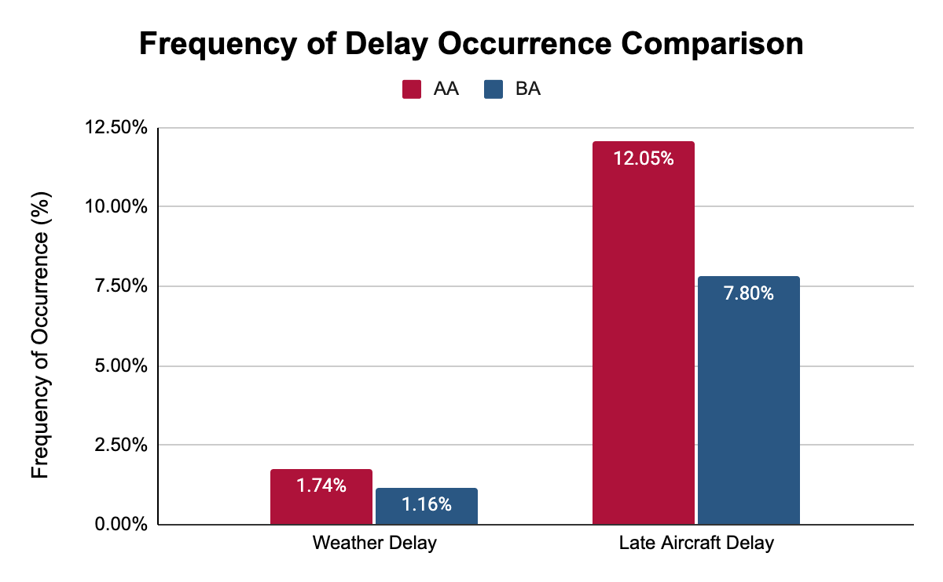
4. Solutions for Systems & Operational Delays Mitigation

Slide 41

4. Solutions for Systems & Operational Delays Mitigation
Solution J
Invest in Advanced Weather Forecast Technologies
Plan Flight Routes in advance
Schedule plane landings effectively

Slide 42
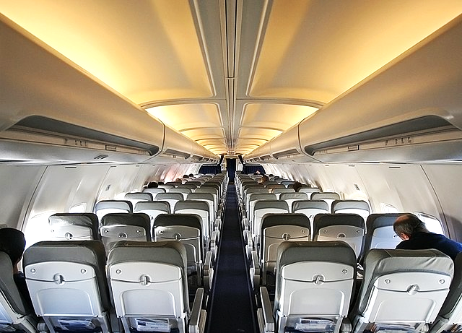
Thank You
Any Questions?

